Slide 1

Global Academy of Technology Department of Computer Science and Engineering
Technical Seminar (15CSS86)
Hadoop Workloads Characterization for Performance and Energy Efﬁciency Optimizations on Microservers
Name : PRAVEEN G
USN : 1GA15CS109
Guide : Mrs. JYOTHI R
Assistant Professor
Dept. of CSE, GAT

Slide 2
Index
Objective
Abstract
Introduction
Technologies Used
Implementation
Applications
Comparison Results
Conclusion & Future Scope
Bibliography

Slide 3
Objectives
The main objective of this model is to create a optimal system where the energy consumption can be decreased in the data center.
As a consequence, hardware design companies have considered energy efﬁciency as one of the main design concerns and have provided mechanisms to ease developing green applications.
The energy demand of data centers that support MapReduce model is increasing rapidly which is the main objective for their scalability.

Slide 4
Abstract
The traditional low-power embedded processors such as Atom and ARM are entering into the high-performance server market.
At the same time, big data analytics applications are emerging and dramatically changing the landscape of data center workloads.
The rapid growth in the data yields challenges to process them efﬁciently using current high-performance server architectures.

Slide 5
Introduction
Low power is one of the main constraints for the design of battery operated embedded systems.
Intel provides RAPL interface which enables the software developers to measure and control the power consumption at different domain, including core, package, DRAM and embedded graphic.
Apache Hadoop is an open-source Java-based framework of MapReduce implementation.
Micro servers employ embedded low power processors as the main processing unit.

Slide 6
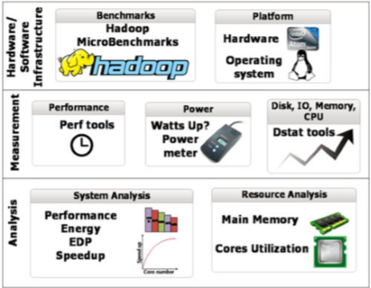
Methodology

Slide 7
Technologies Used
RAPL interface.
ARM has introduced big . LITTLE.
Low power little cores in Blue Gene/Q.

Slide 8
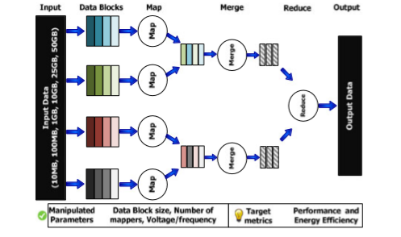
Implementation
A simple conceptual view of the Hadoop data ﬂow.

Slide 9
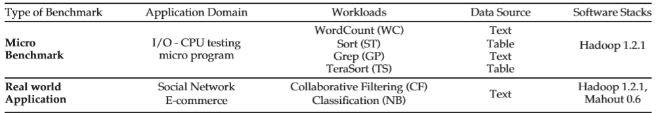
Application
In this implementation they have included four micro-benchmarks in our study, namely Word Count-WC, Sort-ST, Grep-GP and Tera Sort-TS.
The Table shows Hadoop micro-bench-marks and real-world applications for this study along with their particular domain and datatype.
Hadoop micro-bench marks

Slide 10
Comparison & Results
The resource utilizations including CPU utilization and memory footprint are saved at run-time in CSV ﬁle and then processed by R, an environment for statistical analysis.
MapReduce execution breakdown, including setup, map, reduce and clean up phases is obtained through parsing the log ﬁles of Hadoop framework.
The main analysis of this includes performance, EDP, MapReduce execution time breakdown , CPU utilization and main memory footprint.

Slide 11
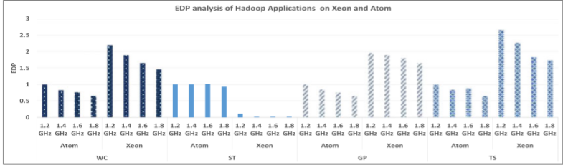
ENERGY EFFICIENCY ANALYSIS ON XEON VERSUS ATOM
EDP analysis of Hadoop applications on Xeon and Atom with frequency scaling

Slide 12
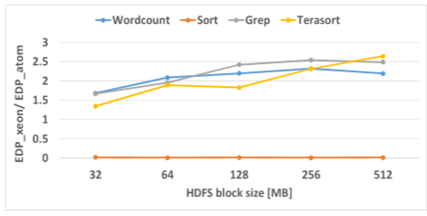
EDP ratio of Hadoop applications on Xeon to Atom at various HDFS block sizes.
The above graphs shows the EDP results on Atom and Xeon. For each workload, the EDP values are normalized to the EDP result on Atom at the lowest frequency of 1.2 GHz and with 512 MB HDFS block size.

Slide 13
Conclusion & Future Scope
Through performance and power measurements and analysis on Atom micro server, it showed that increasing the number of mappers that run simultaneously along with increasing the number of active cores help to maximize energy efﬁciency.
The overall energy efﬁciency is highly decided by the HDFS block size and is different for each benchmark, demonstrating that the default conﬁguration parameters are not optimal.
The impact of scaling the operating frequency of the compute node for the performance and energy efﬁciency. Our results show that big data applications become less sensitive to frequency with large number of mappers.
Results illustrate that the performance and power of compute bound applications are less sensitive to the input data size as compared to I/O bound applications.

Slide 14
Bibliography
[1] Dstat. (2017). [Online]. Available: http://lintut.com/dstat-inuxmonitoring
[2] M. Malik, et al., “Characterizing Hadoop applications on Micro servers for performance and energy efﬁciency optimizations,” in Proc. IEEE Int. Symp. Performance Anal. Syst. Softw., 2018, pp. 153–154.
[3] Apache Mahout. (2017). [Online]. Available: http://mahout. apache.org/
[4] K. Neshatpour, et al., “Accelerating machine learning Kernel in Hadoop using FPGAs,” in Proc. 15th IEEE/ACM Int. Symp. Cluster Cloud Grid Comput., 2019. pp. 1151–1154.

Slide 15
THANK YOU

